Slide 1



COLLECTIVE VISION
Collective behavior course research seminar

Slide 2
GENERAL OVERVIEW OF THE PROBLEM
Our project explores the dynamics of bird flocks and fish schools using a novel vision-based modeling approach. By focusing on visual information rather than spatial representations, we uncover group self-organization principles. Join us in unraveling the subtle yet fascinating interactions that drive collective animal behavior.

Slide 3
STARTING GOAL
Implement the model
Recreate the different behaviors
Add a predator

Slide 4
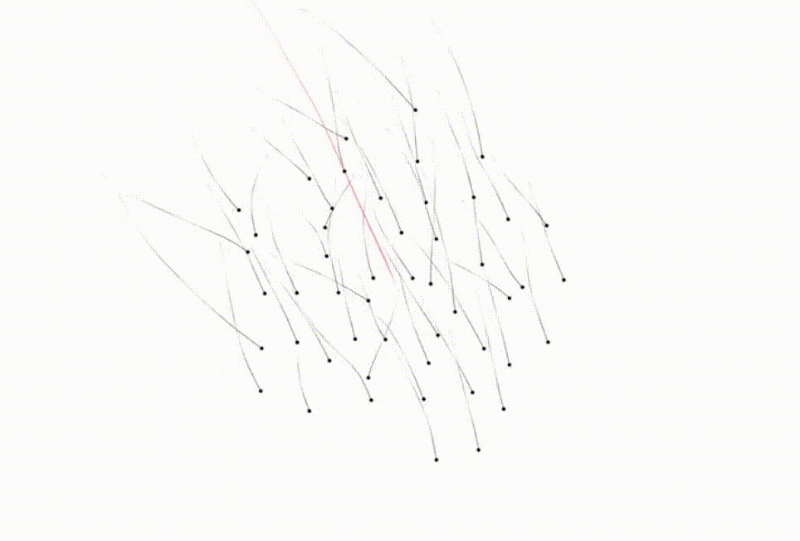
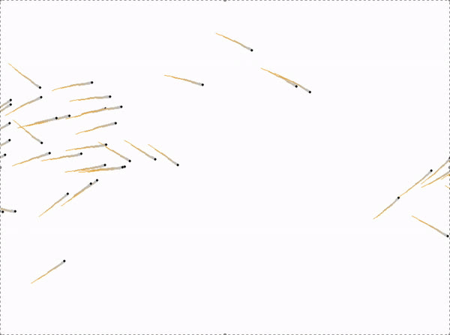
ACHIEVEMENTS
Recreation of the model
Original
Ours

Slide 5
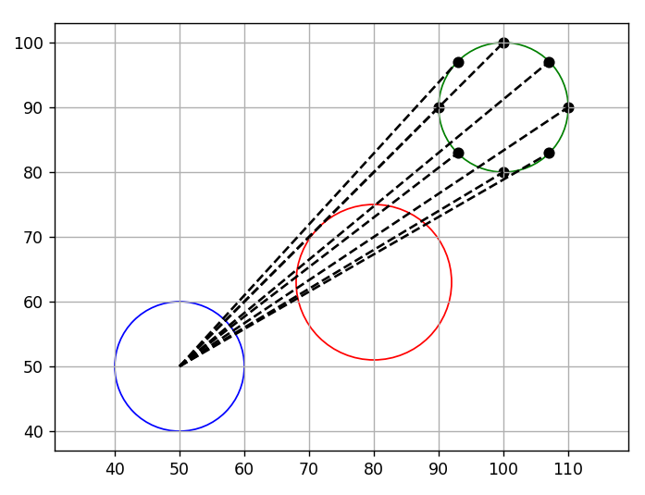
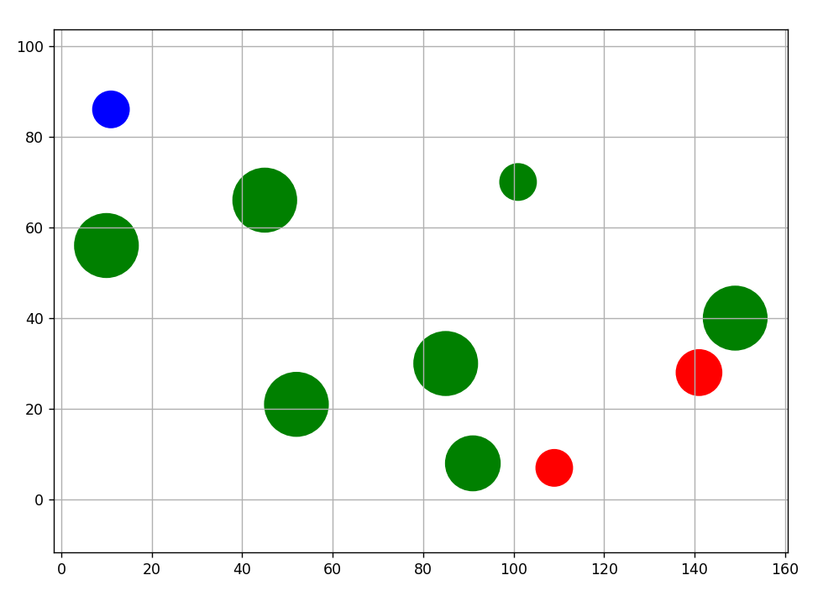
ACHIEVEMENTS
Raycasting

Slide 6
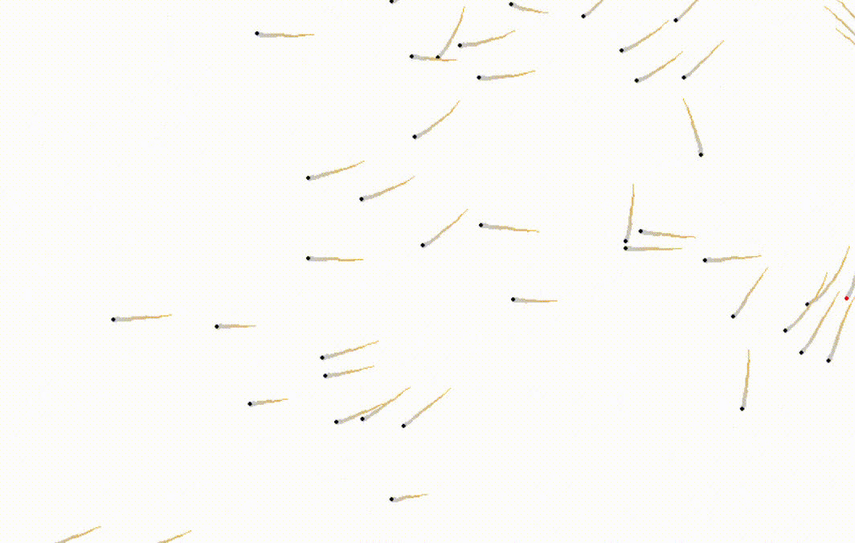
ACHIEVEMENTS
Predator

Slide 7
BIGGEST CHALLENGES AND HOW YOU SOLVED THEM
Implement everything from scratch: the provided implementation was not working at all.
Raycasting was computationally heavy, requiring us to find a more effective option to recreate a model.

Slide 8
WHAT WOULD WE DO DIFFERENTLY
Verify if the chosen paper includes an implementation and contains comprehensive Supplementary Material. It's challenging to build on something when you are missing the base.

Slide 9

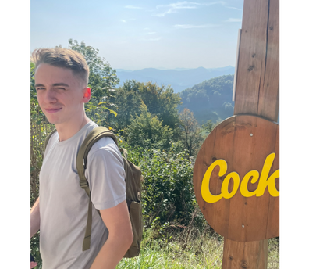
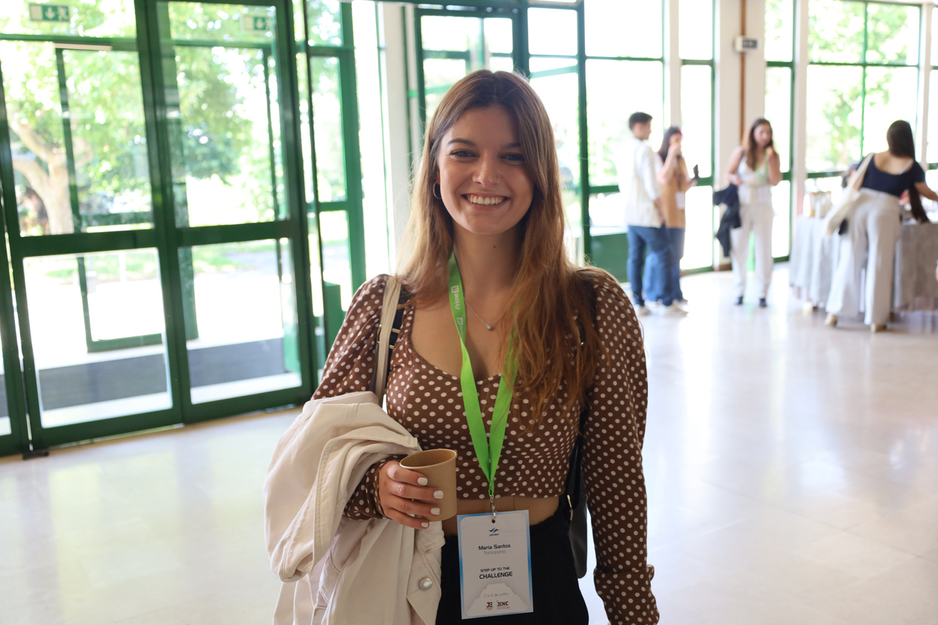


OUR TEAM
Beatriz Lopes dos Santos
Ricardo Ferreira
Tomas Marek
Juraj Kulich

